Slide 1
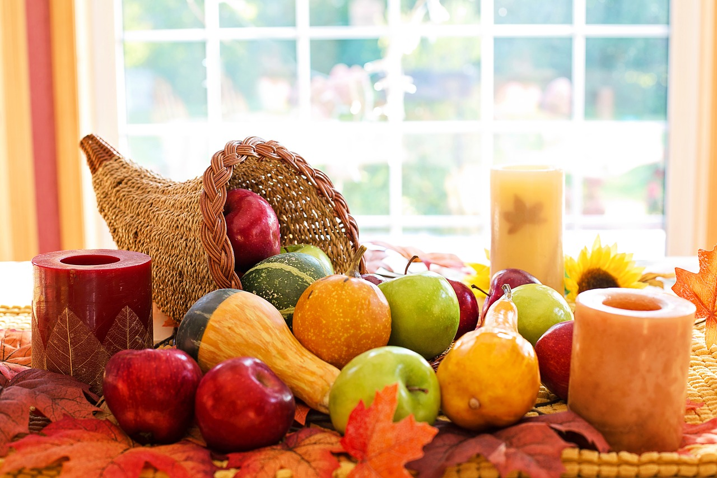
Shopping List Builder
~Thanksgiving Edition~
CODE 201 – November 3, 2018

Slide 2
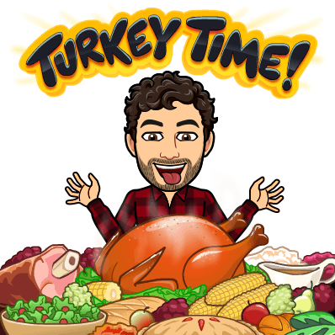
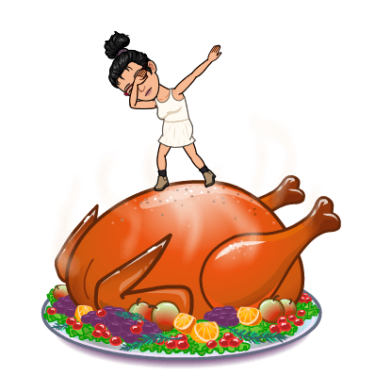

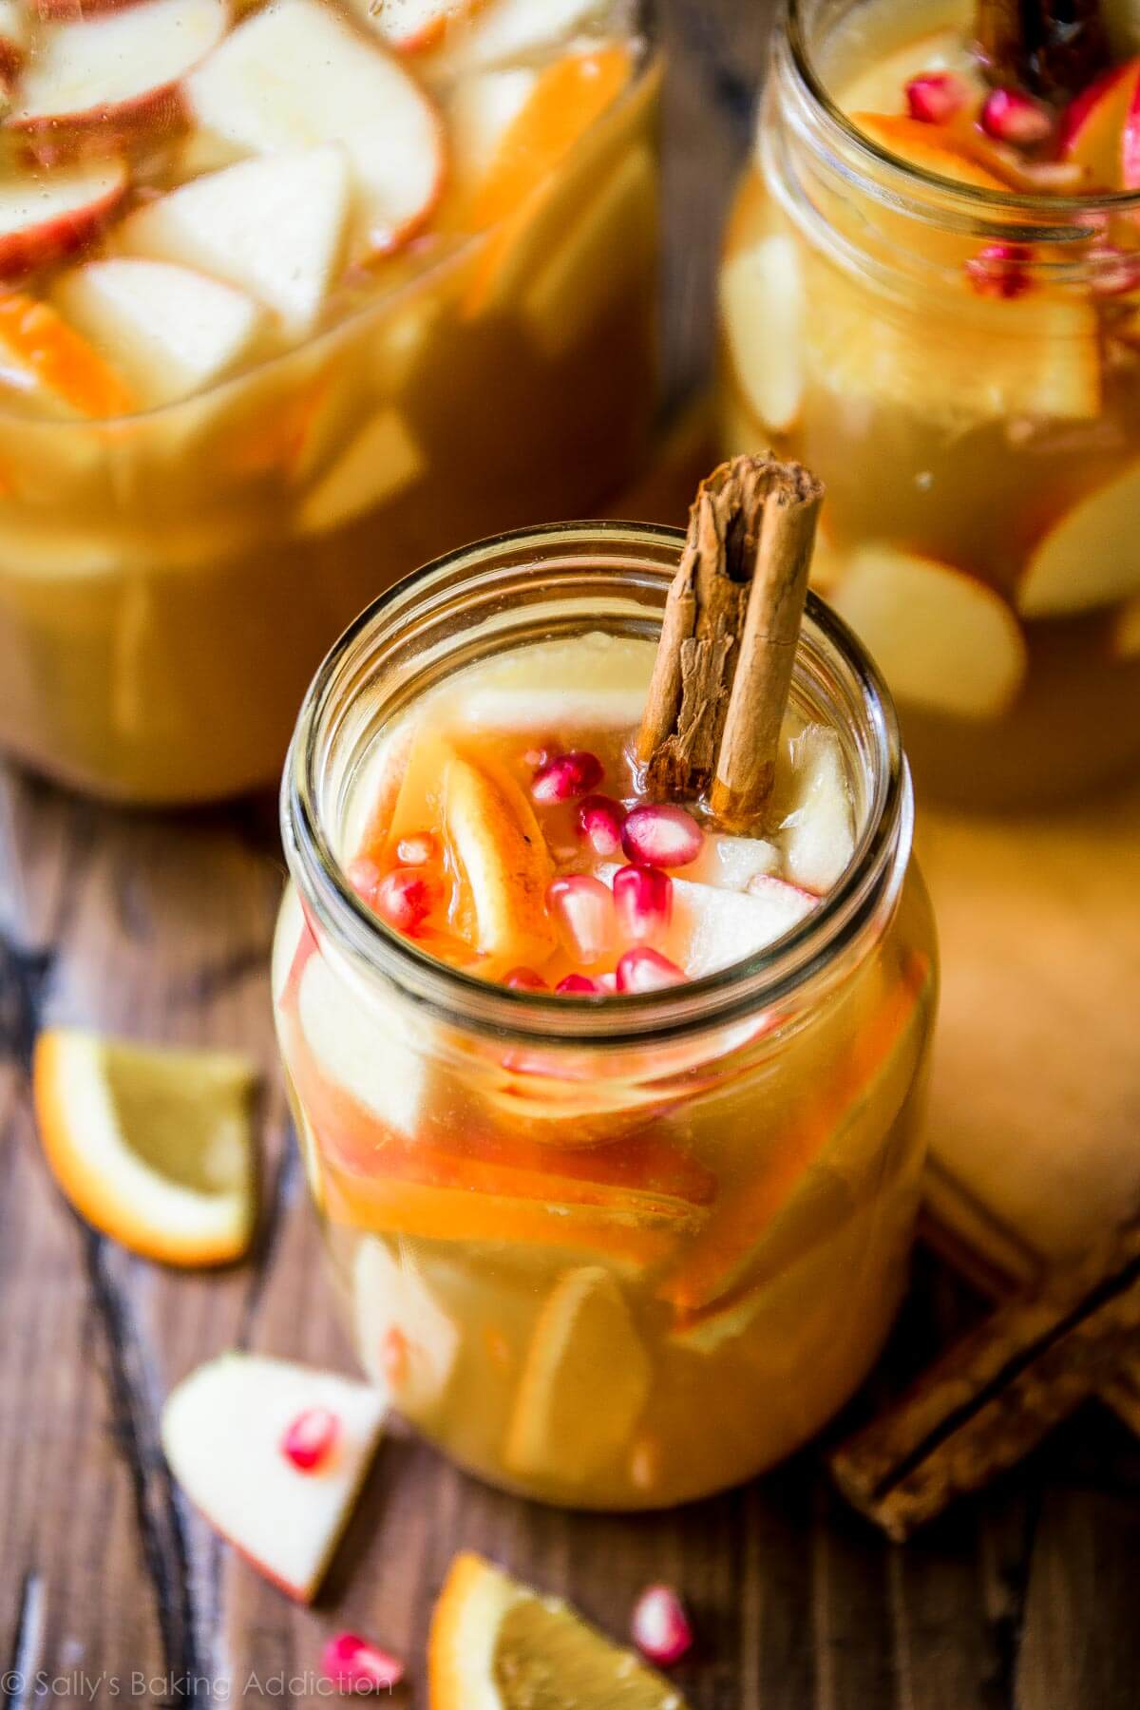

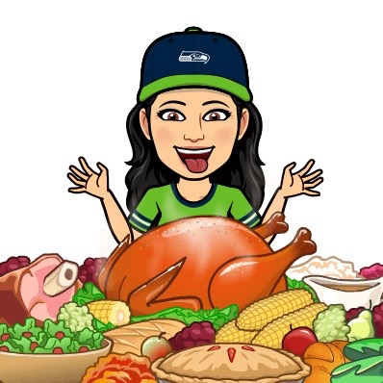
OUR TEAM – SoBasted!
ANTHONY
JULIE
LORIN
ERIN
XOCHIL
Notes:
Each person talks… 1 min backround. Why coding? Future goals.

Slide 3
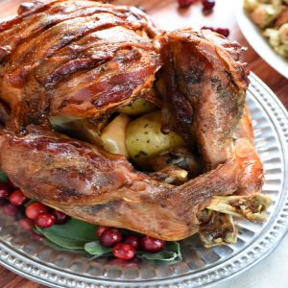
Outline
Team Introductions
Project Description
Problem Domain
Site Demonstration
Technical Challenges and Functionality
Giant Recipe Objects
Changing Buttons
Summing Like Ingredients (Math Functions)
Questions

Slide 4
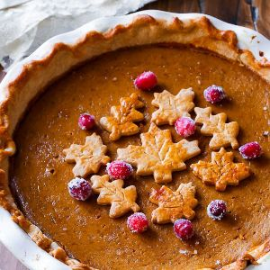
Problem Domain
Create recipe Objects that take in ingredient parameters which can then be manipulated to render a menu table and shopping list of ingredients that sums the ingredient quantities for all recipes selected.

Slide 5
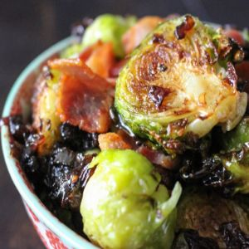
Solution Domain
Click handlers
Added/Removed Recipes from local storage
Used the DOM to change IDS based on user behavior
Math Functions
Reference data from local storage
Loop through all ingredients in the
selected recipe to combine and
manipulate the stored data

Slide 6
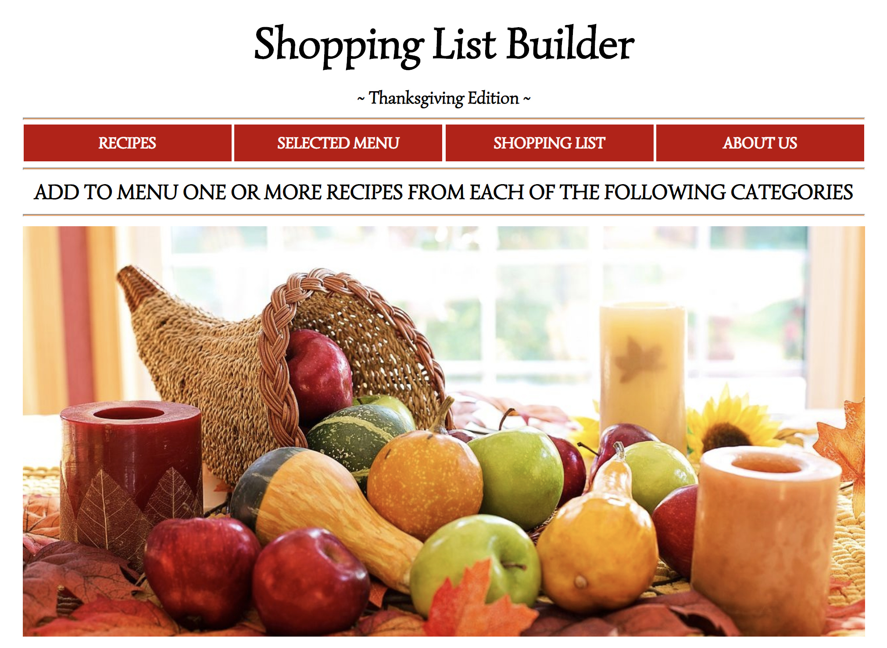
Site Demonstration

Slide 7
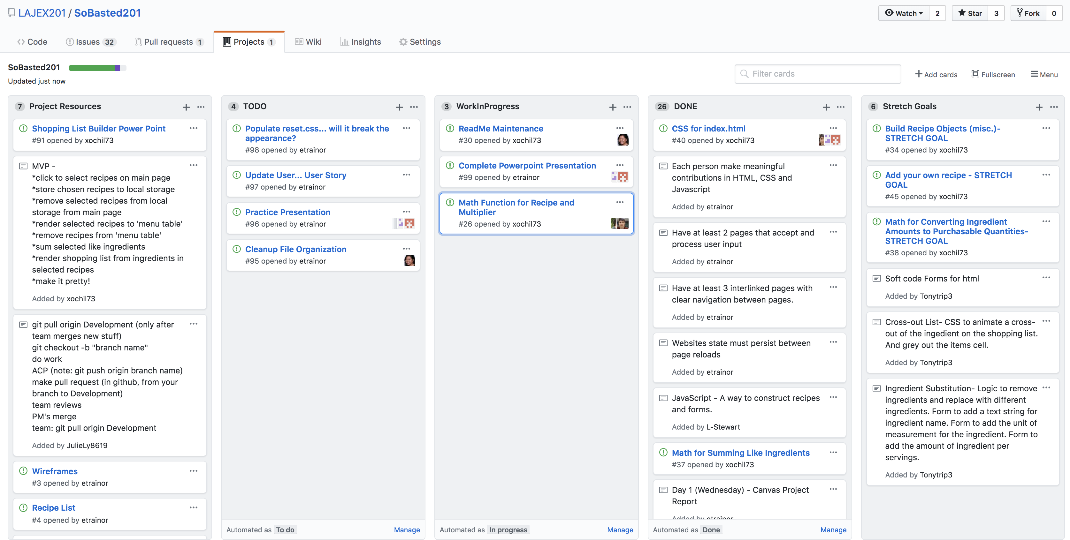
Project Organization – GitHub Projects

Slide 8
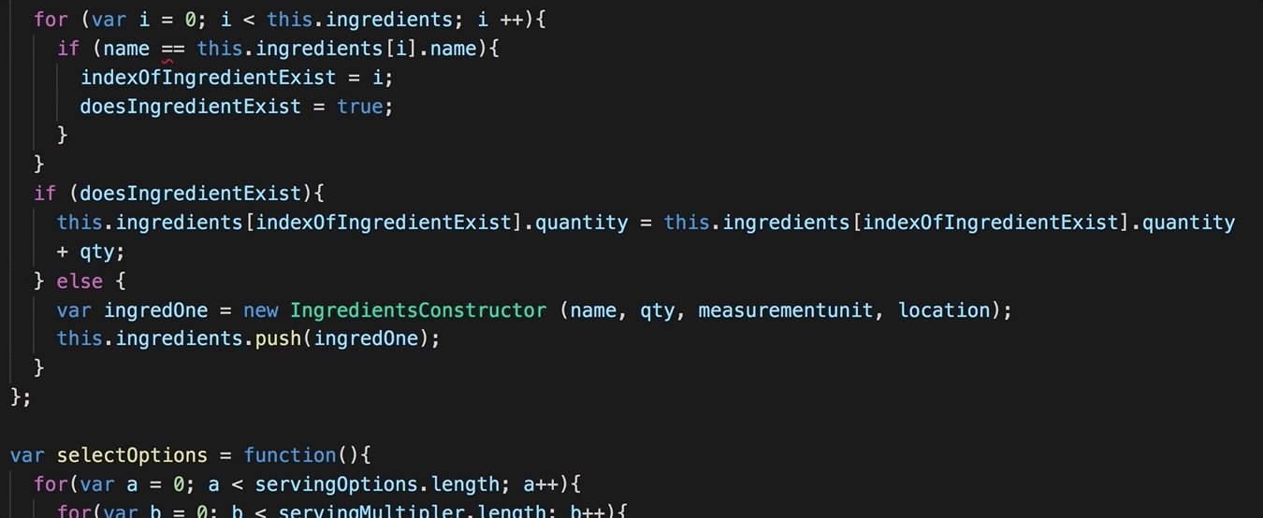
Giant Recipe Objects
Notes:
Each person talks… 1 min backround. Why coding? Future goals.

Slide 9
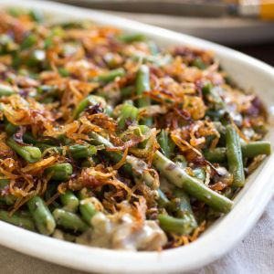
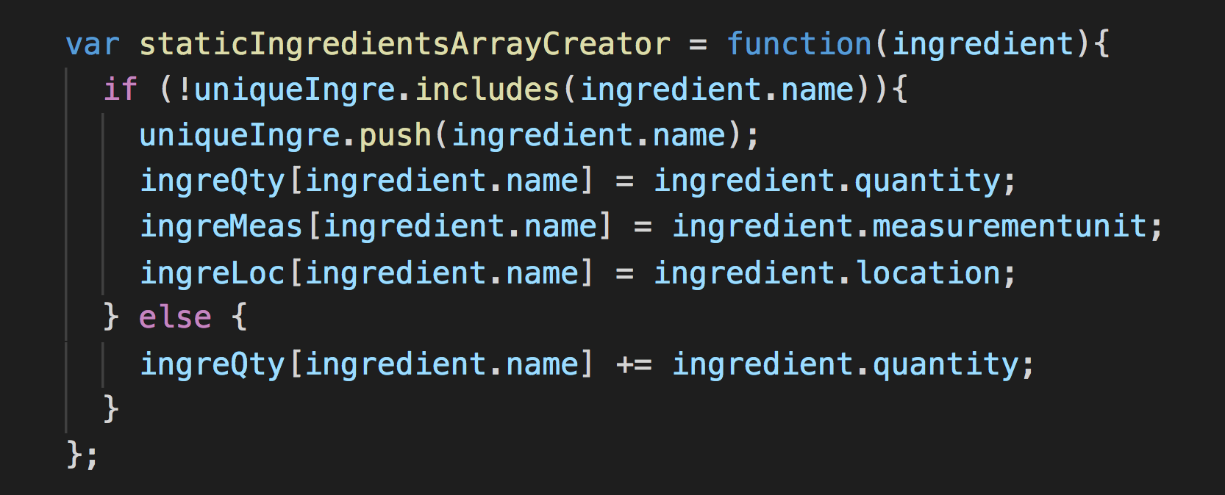
Sum Like Ingredients
Challenge: Combine the quantities and units of ingredients that appear in more than one selected recipe
Example: 2 tablespoons of flour and 1 cup of flour

Slide 10
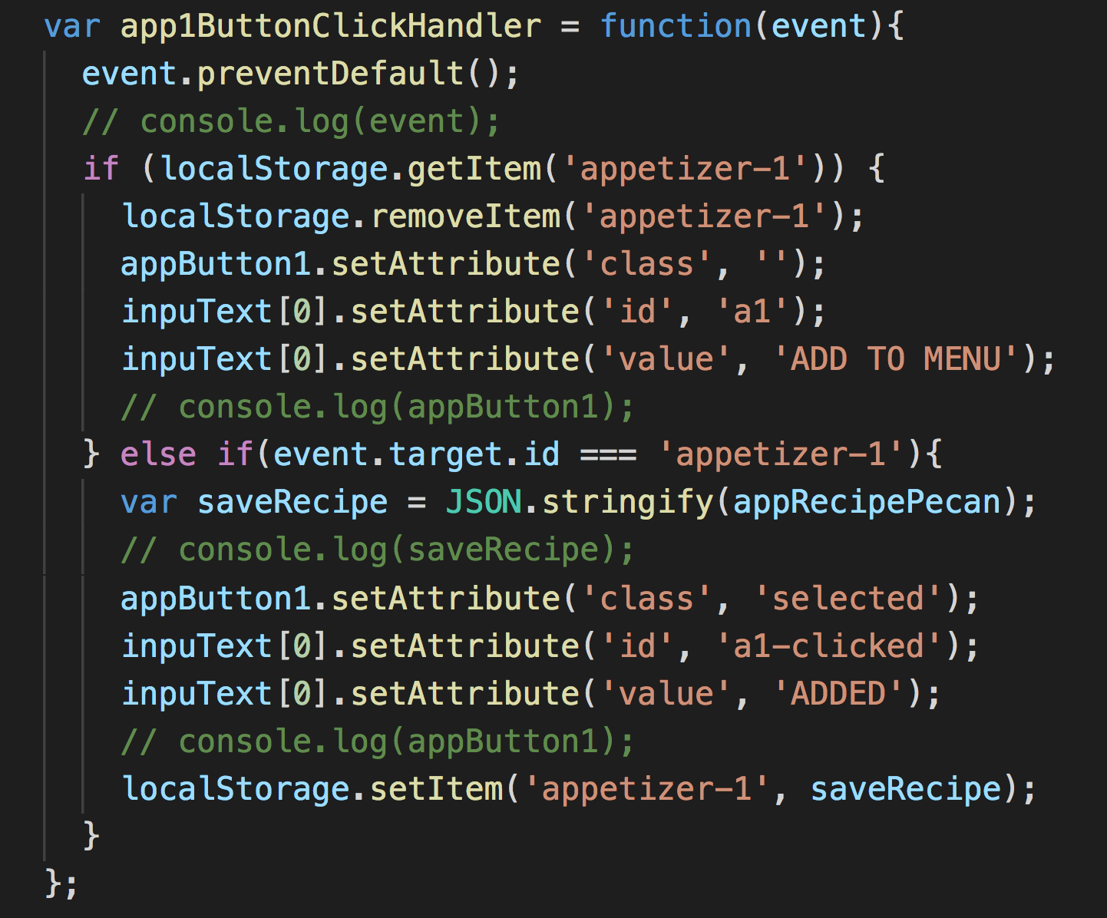
Changing Buttons
Challenge: Create a visual representation of what recipes have been selected by the user that persists on page reload.

Slide 11
Desired Future Functionality
Add your own recipe
Automatically populate recipe data from outside sources using APIs rather than hardcoding each recipe as a separate object
Automatic conversions of different types of units within ingredients
Convert shopping list quantities to purchasable units
Example: Convert cups of flour to pounds of flour
Create a stored recipe database from previous visits to the site

Slide 12
Questions?
CODE 201 – November 3, 2018

